Slide 1
Section 2.6 Multiple Transformations with Inverse, Reciprocals, ABS Values

Slide 2
Review: Reciprocal Functions
In the first part of this section, we will look at combining inverse reflections with reciprocal functions
Algebraically, the reciprocal of function is taking 1 and dividing it by the function.
When graphing a reciprocal function, the “x” coordinates (input) do not change, and the y-coordinates (output) are reciprocated
There are 3 main steps when graphing the reciprocal of a function:
Find the X-intercepts, they become vertical asymptotes! The reciprocal of zero is undefined, so points with a y-coordinate of zero will become a vertical asymptote
Get the “common points”, these are points with a y-coordinate of “±1”. The reciprocal of 1 or -1 stays the same, so these points stay constant.
Far points from x-axis become near and near points become far! This is b/c the reciprocal of a big value becomes small and the reciprocal of small values become big

Slide 3
In general, when the take the reciprocal of a function:
Ex: Graph $y=\frac{1}{f(x)}$ and then state the Domain & Range:
y
y
y
5
5
5
x
x
x
-5
0
5
-5
0
5
-5
0
5
-5
-5
-5

Slide 4
Combining Reciprocals and other transformations
When combining the reciprocal of a function with other transformations, it is best to write out each transformation in steps
Start with the reciprocal of the function:
Since the equation is not factored, start with the translations

Slide 5
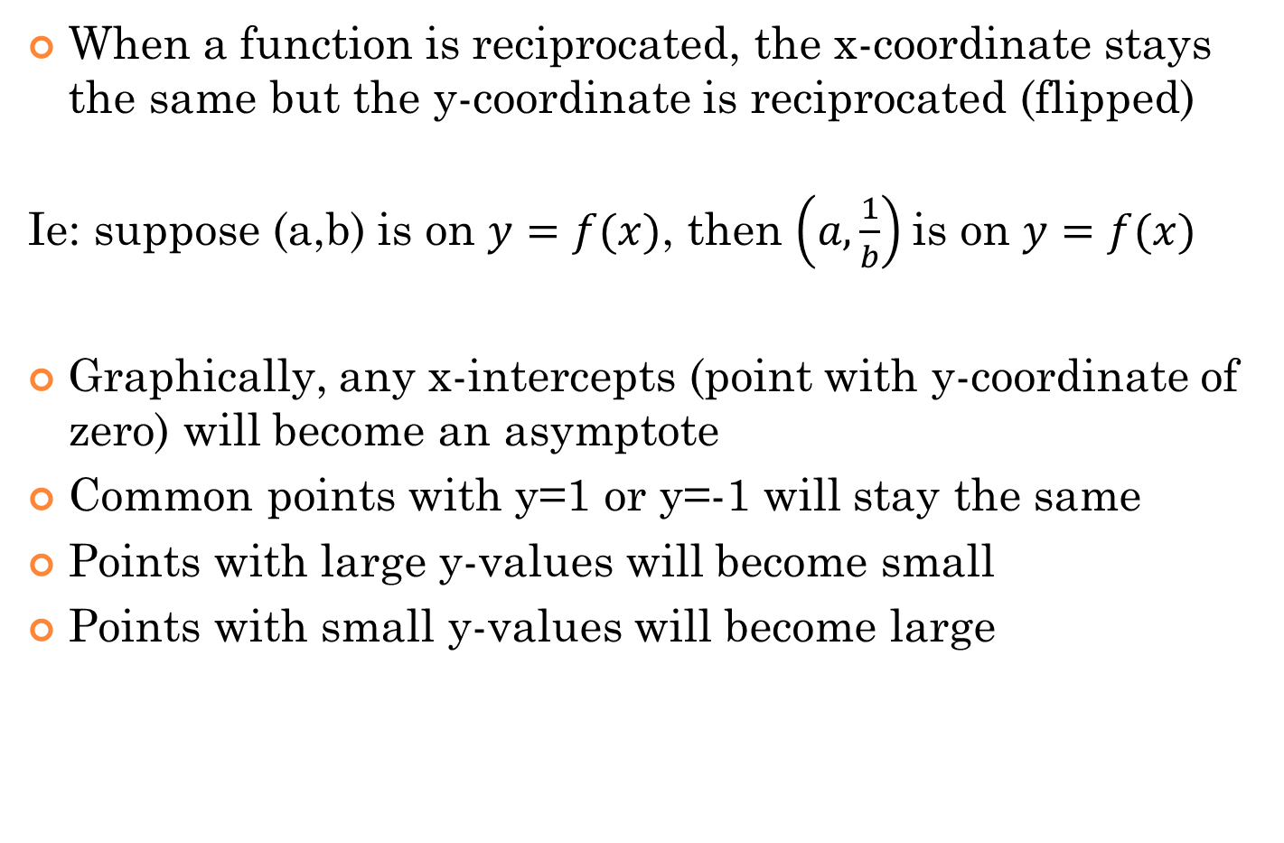
Transformation with Reciprocal Functions
When a function is reciprocated, the x-coordinate stays the same but the y-coordinate is reciprocated (flipped)
Ie: suppose (a,b) is on $y=f(x)$, then $\left(a,\frac{1}{b}\right)$is on $y=f(x)$
Graphically, any x-intercepts (point with y-coordinate of zero) will become an asymptote
Common points with y=1 or y=-1 will stay the same
Points with large y-values will become small
Points with small y-values will become large

Slide 6
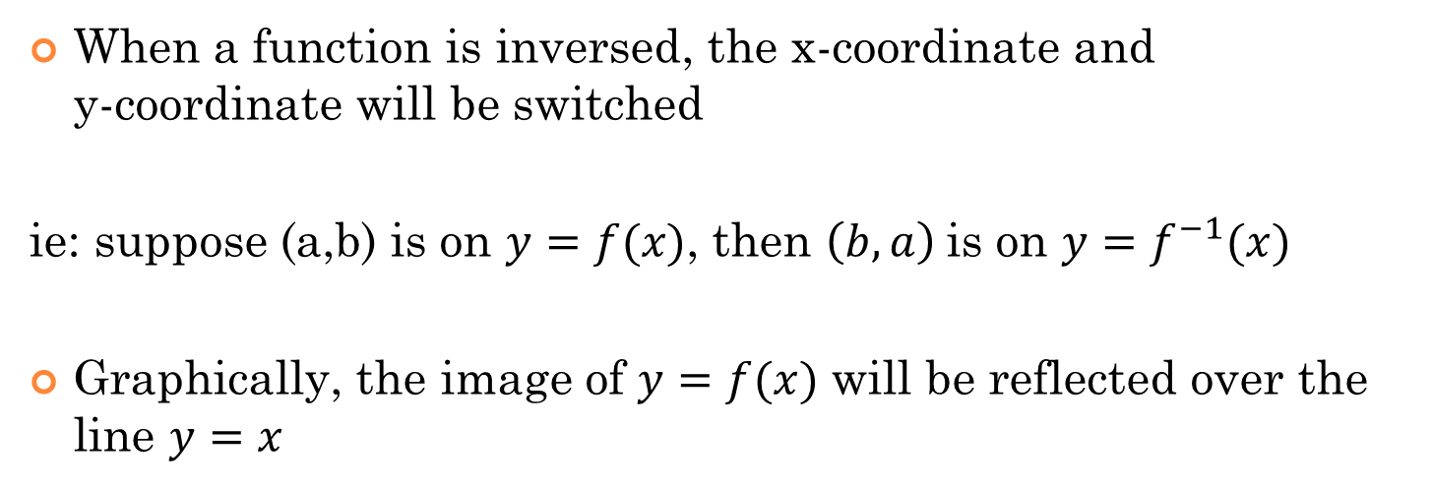
Transformations with Inverse Functions
When a function is inversed, the x-coordinate and y-coordinate will be switched
ie: suppose (a,b) is on $y=f(x)$, then $\left(b,a\right)$is on $y=f^{−1}(x)$
Graphically, the image of $y=f(x)$ will be reflected over the line $y=x$
y
5
4
3
2
1
Reflected over the line y = x
x
-5
-4
-3
-2
-1
0
1
2
3
4
5
-1
-2
-3
-4
-5

Slide 7
III) Inverse Reflection
An inverse reflection is an inverse function:
A reflection over the line y = x
An inverse reflection occurs when the X-variable & Y-variable switches their position. Then the Y-variable is isolated
Ex: Given the function f(x), find the inverse
© Copyright All Rights Reserved Homework Depot www.BCMath.ca

Slide 8






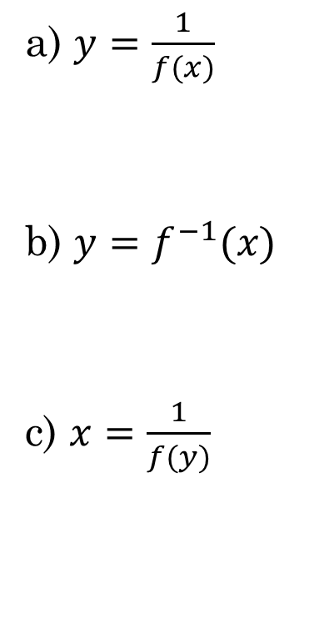

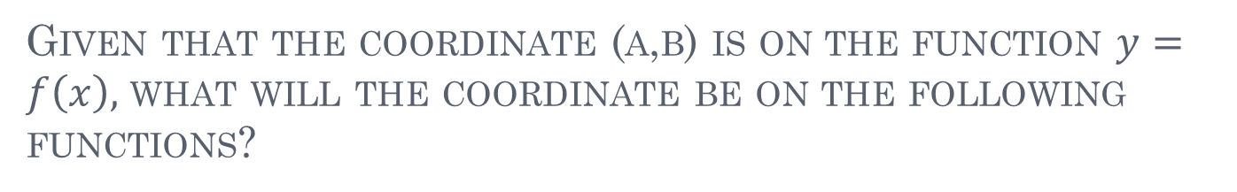

Given that the coordinate (a,b) is on the function $y=f\left(x\right),$ what will the coordinate be on the following functions?
a) $(A,\frac{1}{B})$
b) $(\frac{1}{A},\frac{1}{B})$
a) $y=\frac{1}{f(x)}$
b) $y=f^{−1}(x)$
c) $x=\frac{1}{f(y)}$
C) $(B,\frac{1}{A})$
D) $(\frac{1}{B},\frac{1}{A})$
E) $(A,B)$
F) $(B,A)$
G) $(\frac{1}{A},B)$
H) $(\frac{1}{B},A)$

Slide 9
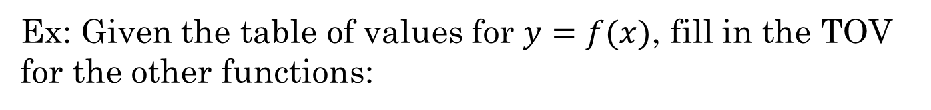
Ex: Given the table of values for $y=f(x)$, fill in the TOV for the other functions:

Slide 10
Ex: Given the table of values for $y=f(x)$, fill in the TOV for the other functions:

Slide 11
Transformation with Absolute Values
There are 4 types of ABS transformations and 3 of them are pretty difficult
This one is the easiest, just take abs of y-values, x-values stay the same. Anything under the x-axis is reflected above
All input values become positive. Negative x-values (left side) all disappears. Positive (right side) is duplicated to the left side
Points on original function with negative y-values will be gone b/c you can’t have negative output values. Graph under the y-axis (bottom side) disappears. Positive (top side) is duplicated to the bottom side
Everything in Q2,Q3,Q4 all disappear. Q1 is duplicated(reflected) to the other 3 Quadrants

Slide 12
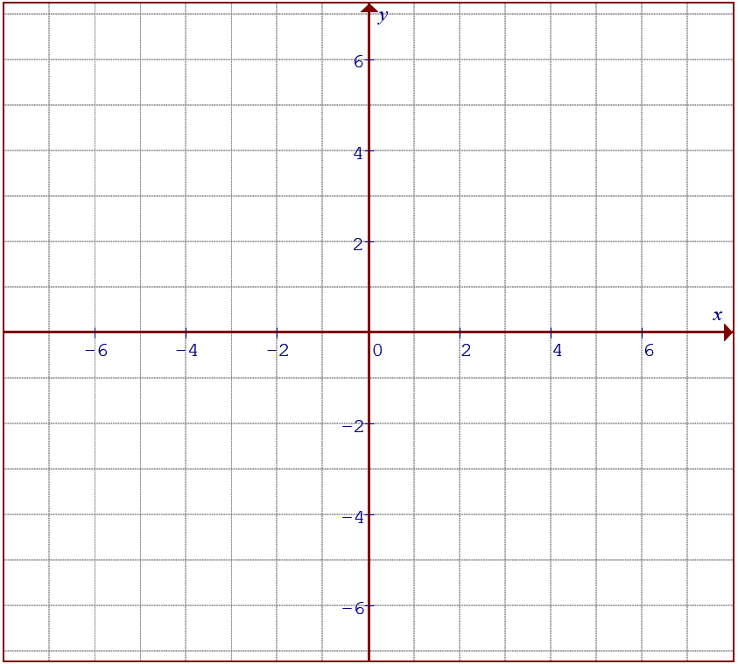
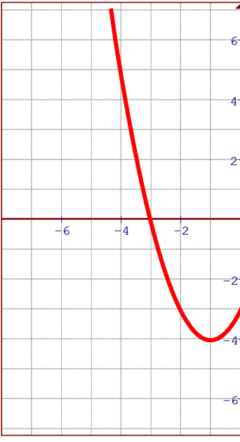
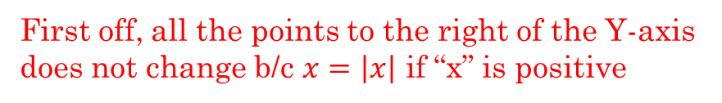
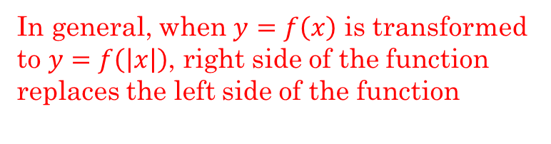
Suppose you have a quadratic function:
First off, all the points to the right of the Y-axis does not change b/c $x=\left|x\right|$ if “x” is positive
Second, all points to the left of the Y-axis disappears and will be replaced with the reflection from the right side
In general, when $y=f\left(x\right)$ is transformed to $y=f\left(\left|x\right|\right)$, right side of the function replaces the left side of the function

Slide 13

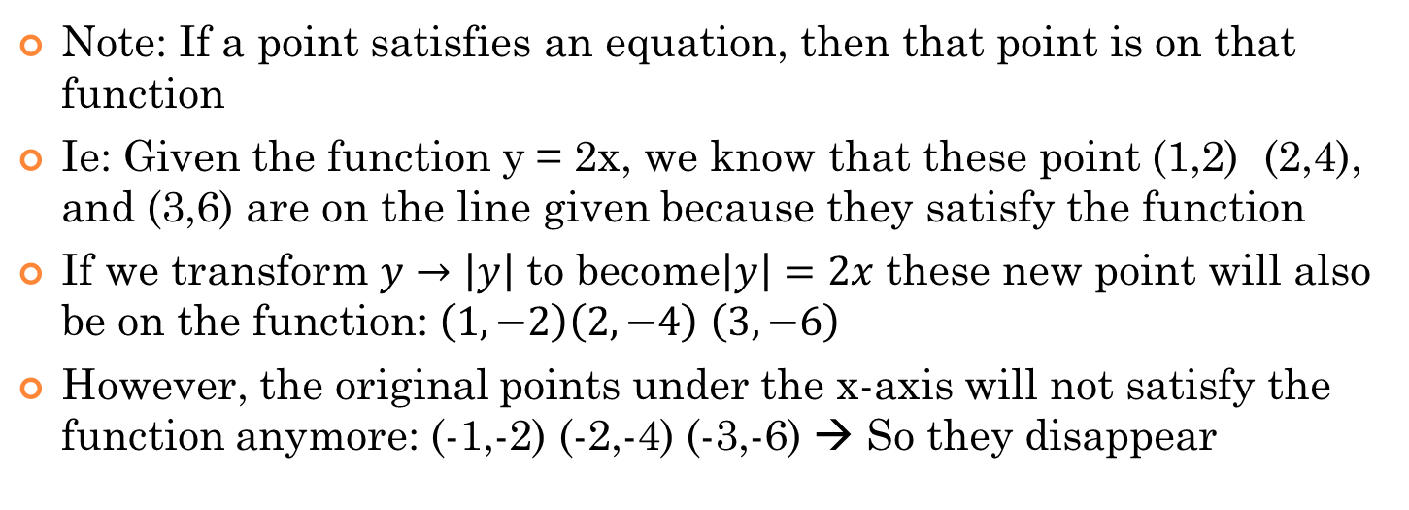
Note: If a point satisfies an equation, then that point is on that function
Ie: Given the function y = 2x, we know that these point (1,2) (2,4), and (3,6) are on the line given because they satisfy the function
If we transform $y→\left|y\right|$ to become$\left|y\right|=2x$ these new point will also be on the function: $\left(1,−2\right)\left(2,−4\right)$ $\left(3,−6\right)$
However, the original points under the x-axis will not satisfy the function anymore: (-1,-2) (-2,-4) (-3,-6) → So they disappear
So in general, the original part under the x-axis disappears
The part above the x-axis is duplicated and reflected vertically under the axis

Slide 14
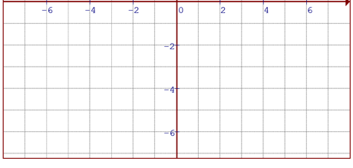
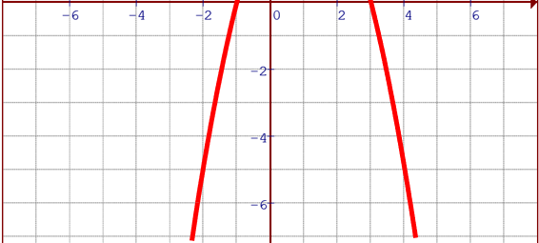
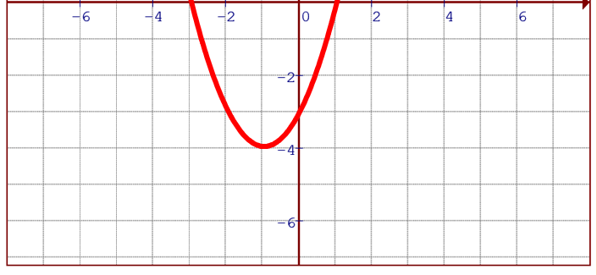
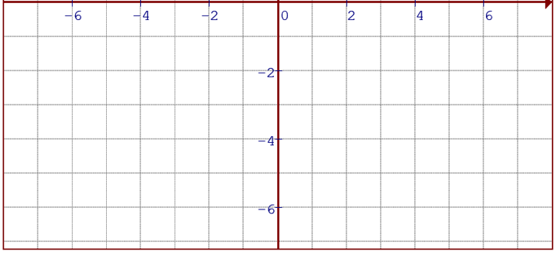
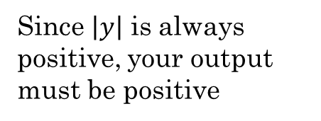

Ex: Graph the functions: $\left|y\right|={\left(x−1\right)}^{2}−4 and \left|y\right|={−\left(x+1\right)}^{2}+4$
and state the Domain and Range
$$\left|y\right|={−\left(x+1\right)}^{2}+4$$
Since $\left|y\right|$ is always positive, your output must be positive
Your domain will then be restricted by the x-intercepts to generate only positive “y” output values
Therefore, any part of the graph under the x-axis will disappear
The part above the x-axis will be duplicated & reflected over the x-axis
Domain:
Range:
Domain:
Range:

Slide 15
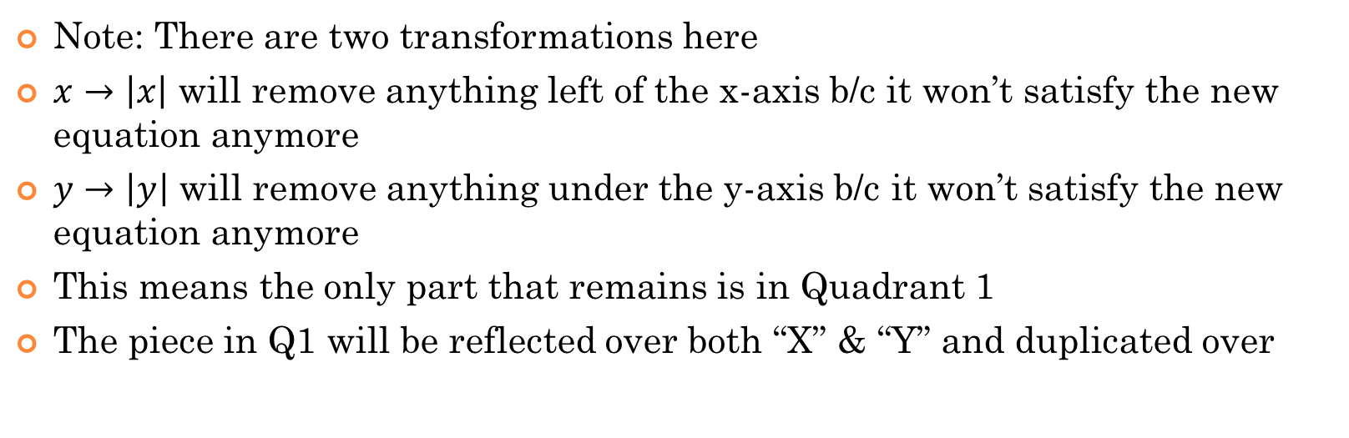
Note: There are two transformations here
$x→\left|x\right|$ will remove anything left of the x-axis b/c it won’t satisfy the new equation anymore
$y→\left|y\right|$ will remove anything under the y-axis b/c it won’t satisfy the new equation anymore
This means the only part that remains is in Quadrant 1
The piece in Q1 will be reflected over both “X” & “Y” and duplicated over

Slide 16
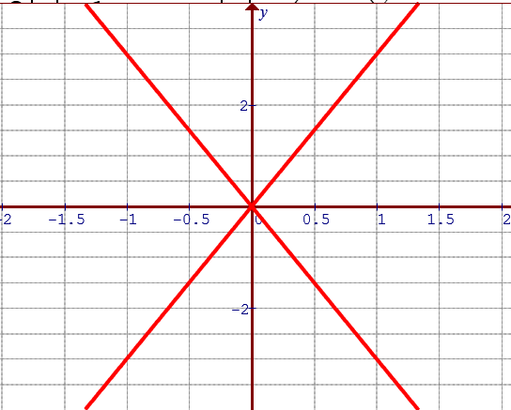
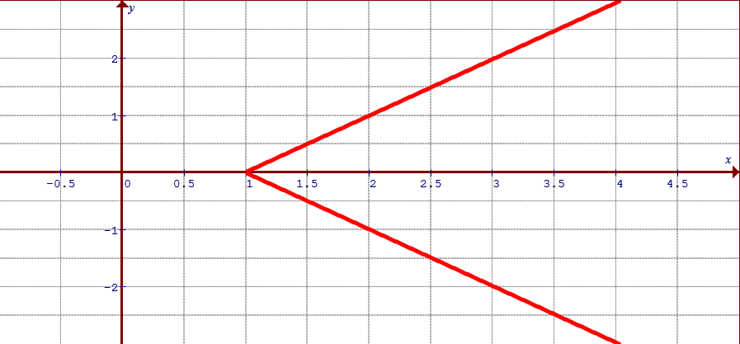
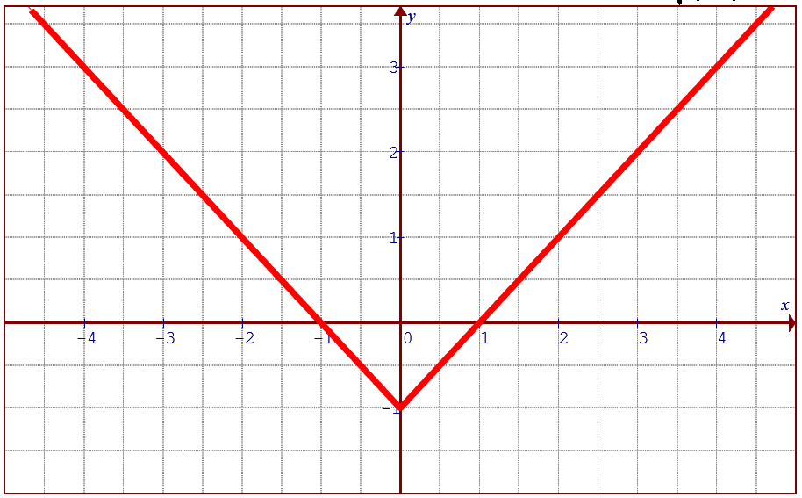
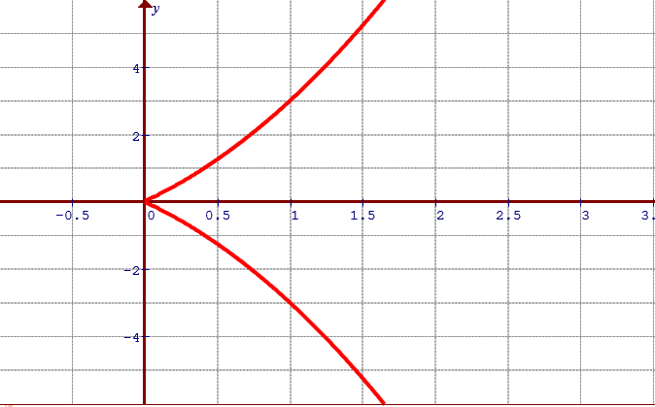
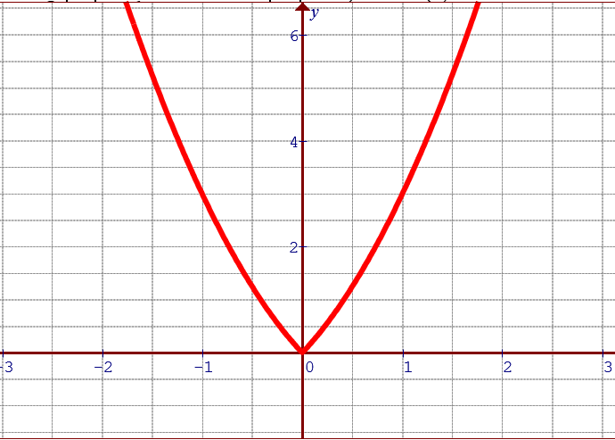
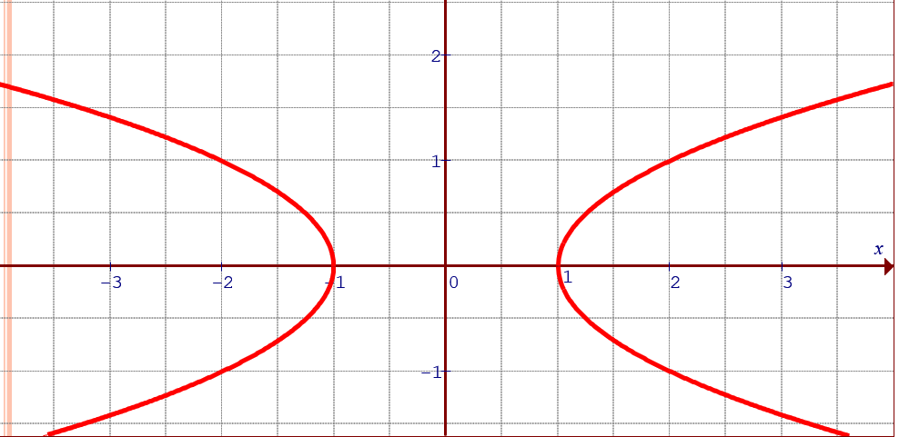
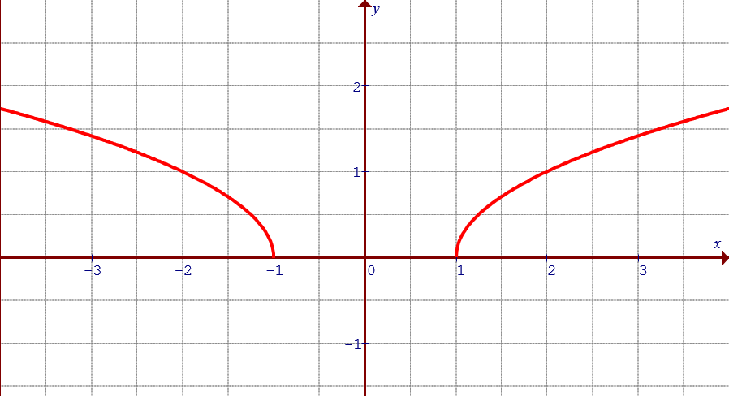
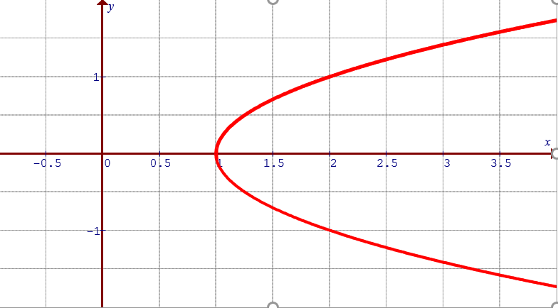
Ex: Match each equation with the corresponding graph
a)
b)
c)
d)
e)
f)
g)
h)

Slide 17
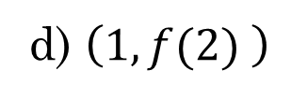
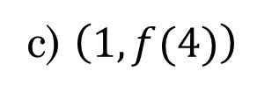
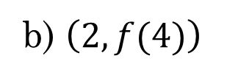
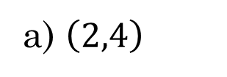
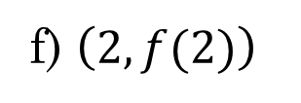

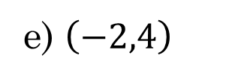
Practice: Given that the point (-2,4) is on $y=f\left(x\right)$, then which of the following points will be on $y=f\left(\left|2x\right|\right)?$
a) $\left(2,4\right)$
b) $\left(2,f(4)\right)$
c) $\left(1,f(4)\right)$
d) $\left(1,f(2) \right)$
e) $\left(−2,4\right)$
f) $\left(2,f(2)\right)$

Slide 18
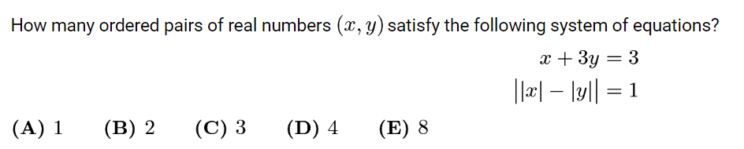

Slide 19
